Slide 1
Unleashing Energy Transition – A Market Driven CO₂ Pricing instead of Red Tape
Proposal of a business-friendly CO₂ pricing system
20th November 2019, Brussels, Johannes Lackmann

Slide 2
Theses in Overview
Industry needs a reliable and effective CO₂ price: un-bureaucratic, competitive, socially balanced, effective, revenue-neutral. With the revenues, the electricity tax is lowered, and the remaining sum goes back to industry and private households. The goals are incentives for efficient system, climate protection and not for raising government revenues.
German industry stands by the climate goals. The commitment to climate policy is based on environmental responsibility and industrial policy reason. A dynamic continuation of the energy transition and a national market with a pioneering function are pre-requisites for being able to remain a technology supplier in the global climate protection.

Slide 3
Theses in Overview
The current climate policy-mix does not, adequately, meet the goal of climate protection or the interests of German industry. ETS gives very low incentives and is highly bureaucratic. It is incompatible for those parts of the economy (agriculture, heat supply, transport), that, so far, have been involved little in climate protection as it has, inter alia, disadvantaged the medium-sized enterprises.
Technology-specific funding laws such as the EEG and KWKG are too rigid frameworks for the future challenges of energy transition. These frameworks must be constantly re-adjusted politically and therefore do not provide sufficient reliability for long investment cycles.

Slide 4
Theses in Overview
Governmental single-subsidy measures from budgetary funds are certainly not an alternative. They mean high administrative costs and little reliability. Inefficiently supervised regulatory law corrects, inadequately only, the low price level of fossil energy sources.

Slide 5
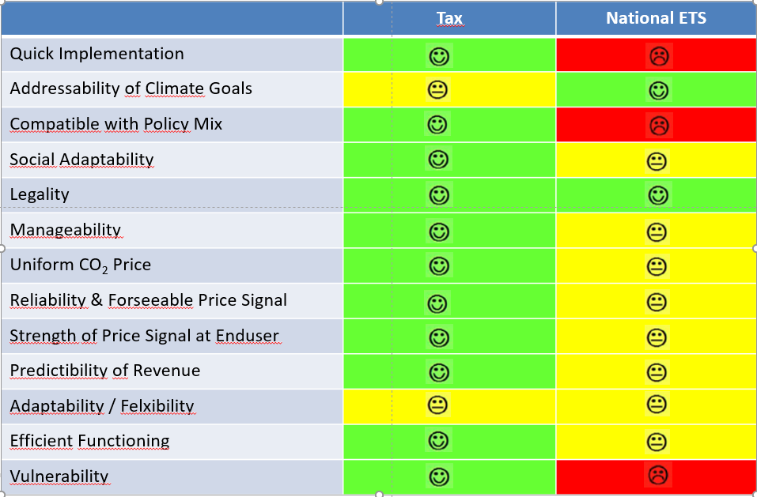
CO₂-Price by Tax or National-
ETS?
Flexibility

Slide 6
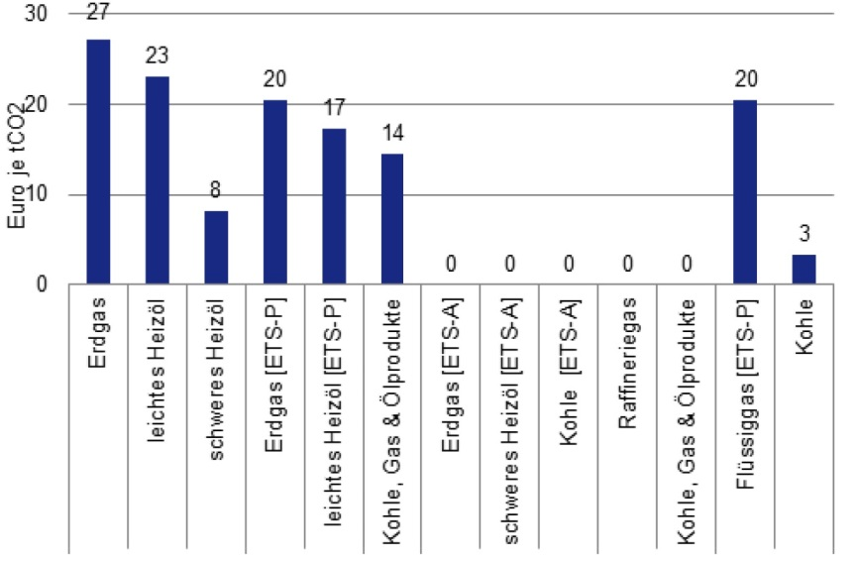
Economy needs CO₂ Price
The tax and spending structure in the energy sector has developed historically and is not geared to climate protection.
Source: FÖS, 2017: Energy Tax Reform for Climate Protection and the Energiewende, p. 9

Slide 7

No Action is not an Alternative
Cost risk for the federal budget of up to 60 billion EURO by 2030 due to the missing targets in the non-ETS sectors.

Slide 8
The Proposed New CO₂-Price
Model Features
Assessment Basis | CO₂
Pricing Level | 2020: 50 EUR/t annual increase by 5 EUR or 10 EUR from 2025 on, in case of missed targets 2030: 100 EUR/t or 130 EUR/t
Scope | ETS: Minimum price in the form of primary energy tax Non-ETS: CO₂-related surcharge on energy tax
Refund within ETS | Industry: sectoral refund Energy sector: no refund

Slide 9
The Proposed New CO₂-Price
Model Features
Refund for non-ETS | Lower electricity price level (3 ct) - lower elec. tax (1.4 ct) - tax funding for industry exemptions from EEG surcharge (besAR) (1.6 ct) Increase in federal spending to social security to lower the employer contribution by 0.5%-points
Refund for private household | As above Additionally, Annual Climate Refund for each Individual (55-66 EUR)

Slide 10






The Proposed New CO₂- Price
Option 1
CO₂-Component to energy tax
Sector 1
Sector 2
Transport
Buildings
Revenue coming from Businesses
Revenue coming from Households

Slide 11






The Proposed New CO₂-
Price – Refund Option 1
Revenue coming from Businesses
Revenue coming from Households
Lower electricity price level, lower employer contribution to social security
Per Capita

Slide 12


The Proposed New CO₂- Price
Option 2
Sector 1
Sector 2
Transport
Buildings
Revenue coming from Sector 1
Revenue coming from Sector 2
Revenue coming from Households

Slide 13

The Proposed New CO₂- Price
Refund Option 2
Revenue coming from Sector 1
Revenue coming from Sector 2
Revenue coming from Households
Private Sector per Capita

Slide 14

The Proposed New CO₂-
Price for the ETS-Sector
Revenue from Businesses
Option 1: Adjustment of energy taxes
Estimating EUA-prices for future year
Annual fixing of tax rate as the difference between minimum price and future EUA-price
EUA – European Emission Allowance

Slide 15
The Proposed New CO₂-
Price for the ETS-Sector
Revenue from Businesses
Option 2: Refund
First, enterprises pay full tax rate
Following year, reduced tax rate to refund ETS-related costs

Slide 16
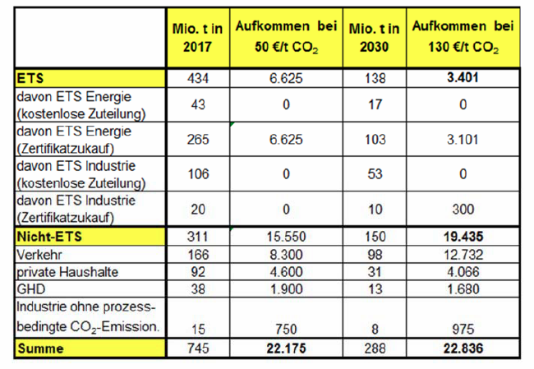
Total Revenue

Slide 17
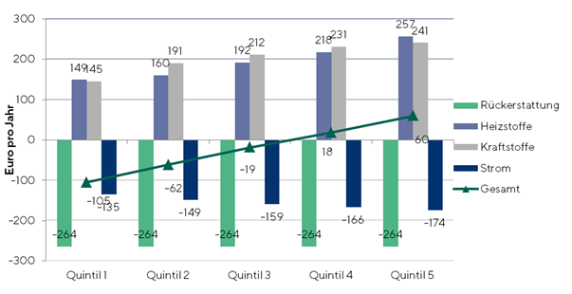
Distributive Effects for
Private Households
Changes in energy expenses per year (four person household) at a rate of 50 Euro/tCO₂
Result: 4-Person-households within the lower 60% income pay less (green line „gesamt“)

Slide 18
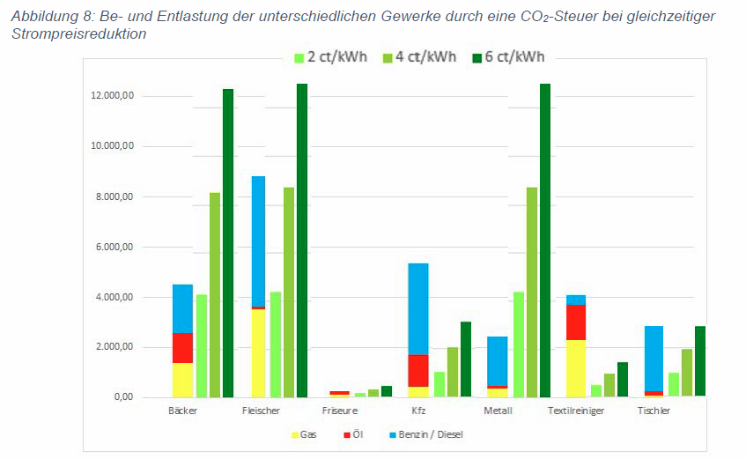
Cost Effects for Energy sector

Slide 19
The New CO₂ Price…
... is unbureaucratic: companies do not need their own trading departments. There are only low transaction costs.
... is completely technology-neutral: debate about efficiency v/s renewable is unnecessary. The most economical solution prevails.
... is competitive, because it is revenue neutral. In the economy, the inefficient players pay and the CO₂ savers are rewarded.

Slide 20
Dynamic Energy Transition
→ Technology Supplier
BDI study "Climatic paths for Germany"
(Federal Association of German Industry)
"Such a modernization of all sectors would offer the opportunity to develop Germany into a leading market for innovative and resource-efficient technologies and to establish German companies as strong providers of technological climate protection on a sustainable basis. This would be all the more valuable, if the international consensus increases the demand for innovative technologies abroad, thereby creating a global market for climate protection technologies. "
→ 1.5 trillion more investments by 2050

Slide 21
ETS Remains Insufficient
All Scenarios, in which targets are met, calculated with higher CO₂-Prices
Quelle: FÖS

Slide 22
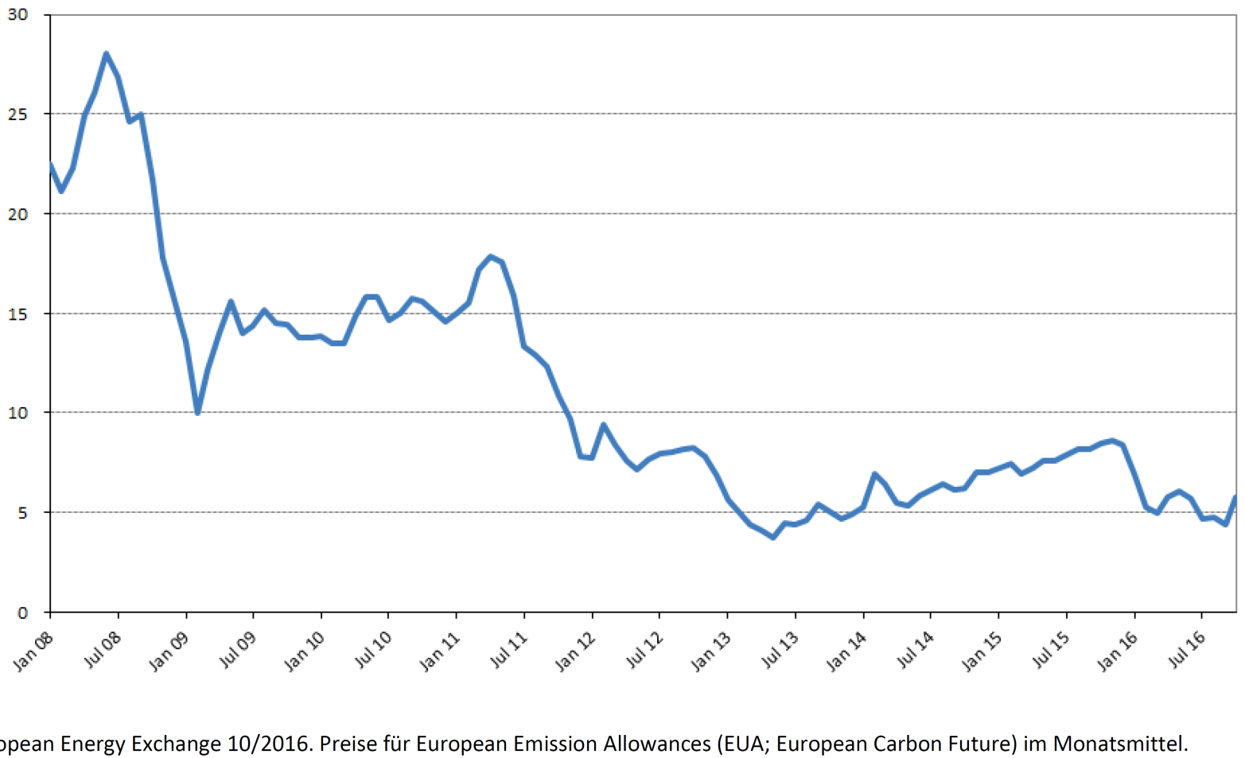
But ETS long time delivered
Erratic Prices on a Low level…
EUA-prices from 2008-2016
Quelle: FÖS

Slide 23
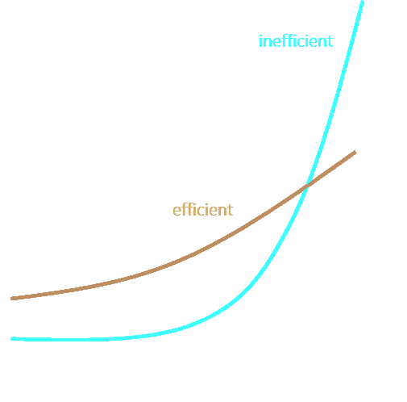
...and a Huge Price Risk in the Long Term
Without intervention, prices remain low for a long time and shoot towards the end.
Either politics sacrifice climate goals or
The long-lived investments in high-carbon techniques from times of low prices are then devalued.
Source: Edenhofer, O. (2017), Decarbonization and EU ETS Reform: Introducing a price floor to drive low-carbon investments
MCC policy paper

Slide 24
Consequences for Economy
Without (minimum) Price
"Inefficient"
No incentive for early, favourable technology development.
Investments with high CO₂ emissions are made and not corrected later, such as fossil heaters in the building sector (lock-in effect).
Low-hanging fruits in climate protection are not harvested at low prices. The emissions-budgets will no longer be available later. (Climate protection is about a limited total CO₂ budget, unlike pollution limits in pollution control)

Slide 25
Consequences for the Economy
With (minimum) Price
"Efficient“
A CO₂ (minimum) price leads to more favourable technology development along usual learning curves (see PV).
It is already worthwhile to invest in existing, climate-friendly technology (such as RE heaters and sector coupling).
Coal is pushed out of the power mix at an earlier stage, driven by the market. This protects the emissions budget.
There is more time for the development of alternatives available for the difficult-to-save, process-related emissions of the industry.

Slide 26
Emissions Trading: No Model for the Whole Industry
Overall, the ETS is still under-priced to be effective.
It only delivers reliable price signals when it is too late.
The prices in the ETS are volatile and thus unpredictable for the industry.
The market players do not trust in persevering politics.

